Slide 1





ASP.NET MVC Essentials
Routing, Controllers, Actions, Views
ASP.NET MVC
SoftUni Team
Technical Trainers
Software University
http://softuni.bg

Slide 2

Table of Contents
ASP.NET MVC Routing
Route constraints
Controllers and Actions
Action results
Razor Views

Slide 3

ASP.NET MVC Routing

Slide 4
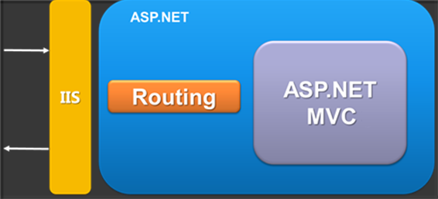
ASP.NET MVC Routing
Mapping between patterns and a combination of
controller + action + parameters
Routes are defined as a global list of routes
System.Web.Routing.RouteTable.Routes
Something similar to Apache mod_rewrite
Greedy algorithm
The first match (from top to bottom) wins

Slide 5
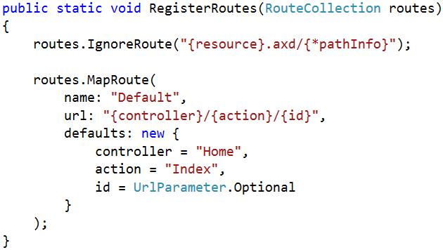
Register routes
In Global.asax in the Application_Start() there is:
RouteConfig.RegisterRoutes(RouteTable.Routes);
RoutesConfig class is located in /App_Start/ in internet applications template by default
Routes to ignore
The [*] means everything else
Route name
Route pattern
Default parameters

Slide 6
Routing Examples
Controller: Products
Action: ById
Id: 3
http://localhost/Products/ById/3

Slide 7
Routing Examples (2)
Controller: Products
Action: ById
Id: 0 (optional parameter)
http://localhost/Products/ById

Slide 8
Routing Examples (3)
Controller: Products
Action: Index
Id: 0 (optional parameter)
http://localhost/Products

Slide 9
Routing Examples (4)
Controller: Home
Action: Index
Id: 0 (optional parameter)
http://localhost/

Slide 10
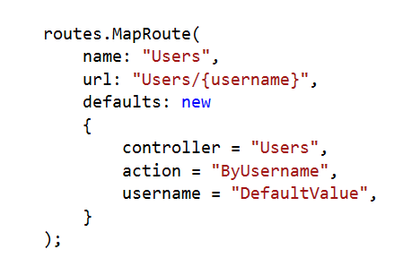
Custom Route
Controller: Users
Action: ByUsername
Username: Nakov
http://localhost/Users/Nakov

Slide 11
Custom Route (2)
Controller: Users
Action: ByUsername
Username: DefaultValue
http://localhost/Users

Slide 12
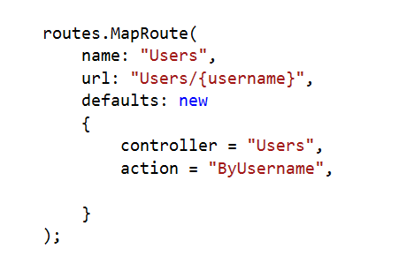
Custom Route (3)
Result: 404 Not Found
?
http://localhost/Users

Slide 13
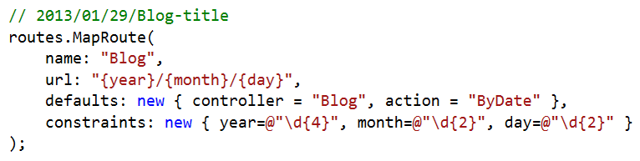
Route Constraints
Constraints are rules on the URL segments
All the constraints are regular expression compatible with class Regex
Defined as one of the routes.MapRoute(…) parameters

Slide 14
Custom Route Constraint
public class LocalhostConstraint : IRouteConstraint
{
public bool Match(HttpContextBase httpContext,
Route route,
string parameterName,
RouteValueDictionary values,
RouteDirection routeDirection)
{
return httpContext.Request.IsLocal;
}
}
routes.MapRoute("Admin",
"Admin/{action}",
new { controller="Admin" },
new { isLocal = new LocalhostConstraint() }
);

Slide 15
Debugging Routes
In actions we have access to a data structure called RouteData
RouteData.Values["controller"]
RouteData.Values["action"]
RouteData.Values["id"]
We can use NuGet package: RouteDebugger
Install-Package RouteDebugger
Web.config (in the <appSettings> section) :
<add key="RouteDebugger:Enabled" value="true" />
We can also use Glimpse for debugging routes

Slide 16
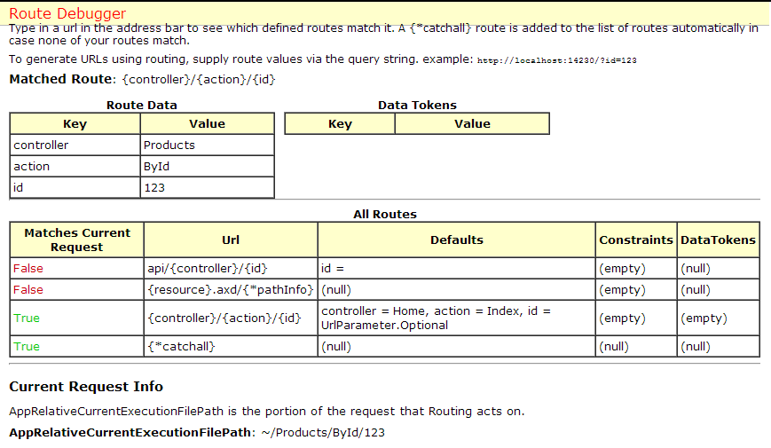
Demo: Routes
ASP.NET MVC Routing

Slide 17
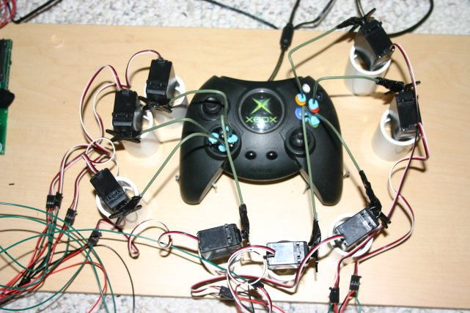
Controllers and Actions
The brain of the application

Slide 18
Controllers
The core component of the MVC pattern
All the controllers should be available in a folder by name Controllers
Controller naming standard should be "NameController"
Routers instantiate controllers in every request
All requests are mapped to a specific action
Every controller should inherit the Controller class
Access to Request (context) and HttpContext

Slide 19
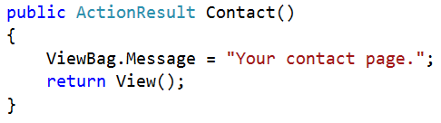
Actions
Actions are the ultimate request destination
Public controller methods
Non-static
No return value restrictions
Actions typically return an ActionResult

Slide 20
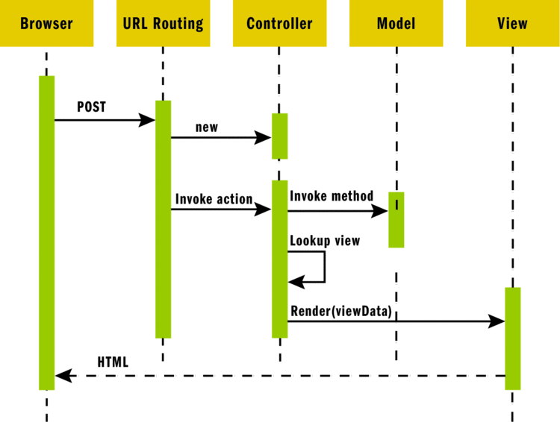
ASP.NET MVC Request

Slide 21
Action Results
Controller action response to a browser request
Inherits from the base ActionResult class
Different result types:
Name | Framework Behavior | Producing Method
ContentResult | Returns a string literal | Content()
EmptyResult | No response
FileContentResult FilePathResult FileStreamResult | Return the contents of a file | File()

Slide 22
Action Results (2)
Name | Framework Behavior | Producing Method
HttpUnauthorizedResult | Returns an HTTP 403 status
JavaScriptResult | Returns a script to execute | JavaScript()
JsonResult | Returns data in JSON format | Json()
RedirectResult | Redirects the client to a new URL | Redirect() / RedirectPermanent()
RedirectToRouteResult | Redirect to another action, or another controller’s action | RedirectToRoute / RedirectToAction
ViewResult PartialViewResult | Response is the responsibility of a view engine | View / PartialView

Slide 23
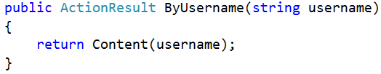
Action Parameters
ASP.NET MVC maps the data from the HTTP request to action parameters in few ways:
Routing engine can pass parameters to actions
http://localhost/Users/Nakov
Routing pattern: Users/{username}
URL query string can contains parameters
/Users/ByUsername?username=VGeorgiev
HTTP post data can also contain parameters

Slide 24
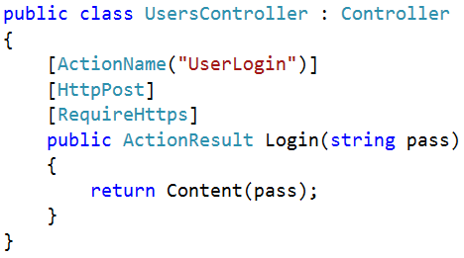
Action Selectors
ActionName(string name)
AcceptVerbs
HttpPost, HttpGet, HttpDelete, HttpOptions…
NonAction
RequireHttps
ChildActionOnly
Prevents the action from being called directly
Can be accessed via Html.Action()

Slide 25
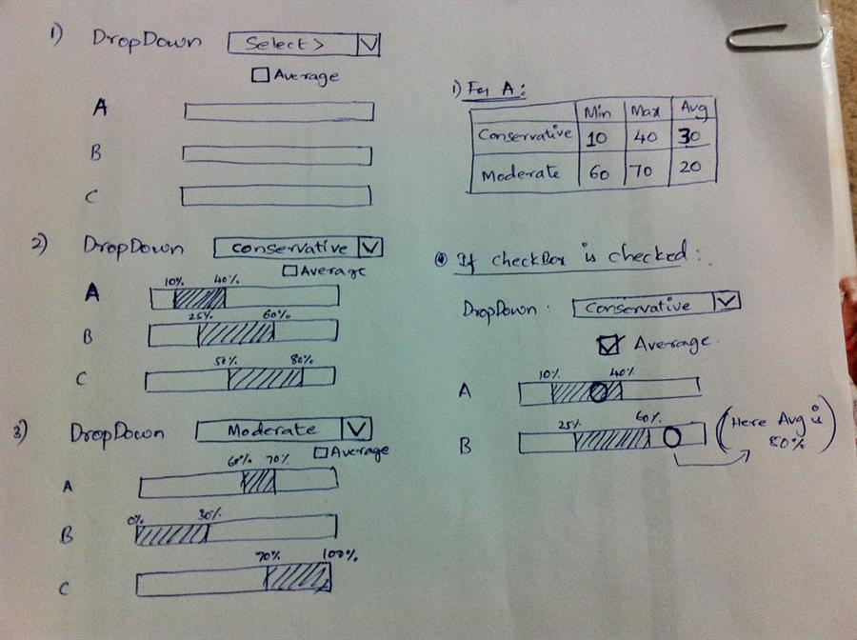
Razor Views

Slide 26
Views
HTML templates of the application
A lot of view engines available
View engines execute code and provide HTML
Provide a lot of helpers to easily generate HTML
The most popular is Razor and WebForms
We can pass data to views through:
ViewBag, ViewData and Model (strongly-typed views)
Views support master pages (layout views)
Other views can be rendered (partial views)

Slide 27
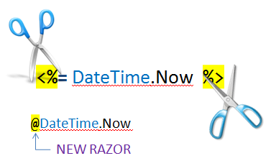
Razor
Template markup syntax
Simple-syntax view engine
Based on the C# programming language
Enables the programmer to use an HTML construction workflow
Code-focused templating approach, with minimal transition between HTML and code
Razor syntax starts code blocks with a @ character and does not require explicit closing of the code-block

Slide 28
Design Goals
Compact, Expressive, and Fluid
Smart enough to differ HTML from code
Easy to Learn
Is not a new language
Works with any text editor
Has great Intellisense
Built in Visual Studio
Unit Testable
Without requiring a controller or a web-server
Template
+
Data
=
Generated Output

Slide 29
Passing Data to a View
With ViewBag (dynamic type):
Action: ViewBag.Message = "Hello World!";
View: @ViewBag.Message
With ViewData (dictionary)
Action: ViewData["message"] = "Hello World!";
View: @ViewData["message"]
With Strongly-typed views:
Action: return View(model);
View: @model ModelDataType;

Slide 30
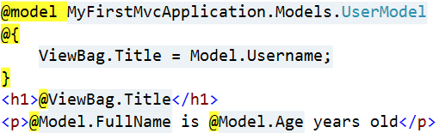
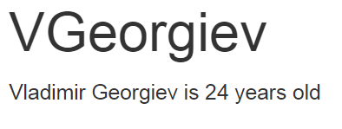
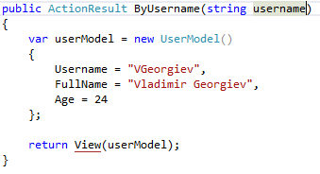
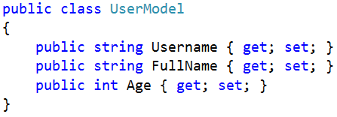
How Does It Work?
ByUsername.cshtml
HTML Output
Template
+
Data
=
Generated Output
UsersController.cs
UserModel.cs

Slide 31
Razor Syntax
@ – For values (HTML encoded)
@{ … } – For code blocks (keep the view simple!)
<p>
Current time is: @DateTime.Now!!!
Not HTML encoded value: @Html.Raw(someVar)
</p>
@{
var productName = "Energy drink";
if (Model != null)
{
productName = Model.ProductName;
}
else if (ViewBag.ProductName != null)
{
productName = ViewBag.ProductName;
}
}
<p>Product "@productName" has been added in your shopping cart</p>

Slide 32
Razor Syntax (2)
If, else, for, foreach, etc. C# statements
HTML markup lines can be included at any part
@: – For plain text line to be rendered
<div class="products-list">
@if (Model.Products.Count() == 0)
{
<p>Sorry, no products found!</p>
}
else
{
@:List of the products found:
foreach(var product in Model.Products)
{
<b>@product.Name, </b>
}
}
</div>

Slide 33
Razor Syntax (3)
Comments
What about "@" and emails?
@*
A Razor Comment
*@
@{
//A C# comment
/* A Multi
line C# comment
*/
}
<p>
This is the sign that separates email names from domains: @@<br />
And this is how smart Razor is: spam_me@gmail.com
</p>

Slide 34
Razor Syntax (4)
@(…) – Explicit code expression
@using – for including namespace into view
@model – for defining the model for the view
<p>
Current rating(0-10): @Model.Rating / 10.0 @* 6 / 10.0 *@
Current rating(0-1): @(Model.Rating / 10.0) @* 0.6 *@
spam_me@Model.Rating @* spam_me@Model.Rating *@
spam_me@(Model.Rating) @* spam_me6 *@
</p>
@using MyFirstMvcApplication.Models;
@model UserModel
<p>@Model.Username</p>

Slide 35

Summary
Routes
Map URLs to controllers and actions
Controllers
The "brain" of our application
Actions
The ultimate request destination
Razor
A powerful engine for combining models and templates into HTML code

Slide 36









ASP.NET MVC Essentials
https://softuni.bg/trainings/1230/asp-net-mvc-october-2015

Slide 37
License
This course (slides, examples, demos, videos, homework, etc.) is licensed under the "Creative Commons Attribution-NonCommercial-ShareAlike 4.0 International" license
Attribution: this work may contain portions from
"ASP.NET MVC" course by Telerik Academy under CC-BY-NC-SA license

Slide 38





Free Trainings @ Software University
Software University Foundation – softuni.org
Software University – High-Quality Education, Profession and Job for Software Developers
softuni.bg
Software University @ Facebook
facebook.com/SoftwareUniversity
Software University @ YouTube
youtube.com/SoftwareUniversity
Software University Forums – forum.softuni.bg

